Slide 1

Ho Chi Minh City Land Price Prediction model
Vo Khang Di

Slide 2

Introduction
Business problem

Slide 3

Real Estate Industry
Real Estate is an extremely lucrative industry which revolves entirely around land prices.
Predicting the fluctuations of land prices ultimately decides who profits and who pays the price in business.

Slide 4
Land price prediction
Being able to predict land prices would help both existing and potential investors to be able to:
Predict the rise or fall of owned property prices, based on observable or other predicted changing factors, to be able to buy or sell them.
Predict property price on yet to be built projects.
Accurately measure the price of owned property before selling them so as not to undersell.
Estimate cost of property while looking to purchase so as not to overpay.
Plan facilities to be built on newly acquired land to maximize land prices once projects are completed.

Slide 5
Data Acquisition
The average land prices in each district will be scraped from a very well-known Vietnamese real estate website: mogi.vn
The number and types of landmarks of the defined area will be provided by Foursquare API
The coordinates of each district will be provided by Google Maps API geocoding
The boundaries of each district will be gathered on Google and drawn onto a geojson file
The distance to the city center can be calculated using their coordinates

Slide 6
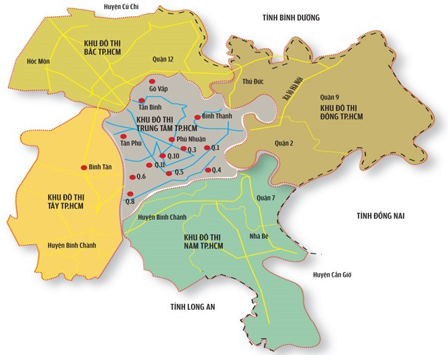
Data filtering
District 1 (Q.1 on the map) is the economic center → land prices drop the farther away you go.
The four large surrounding areas are sparsely populated suburbs or uninhabited empty land.
To minimize outliers and improve model accuracy → eliminate areas with land that stakeholders are not interested in and/or mostly uninhabited.

Slide 7
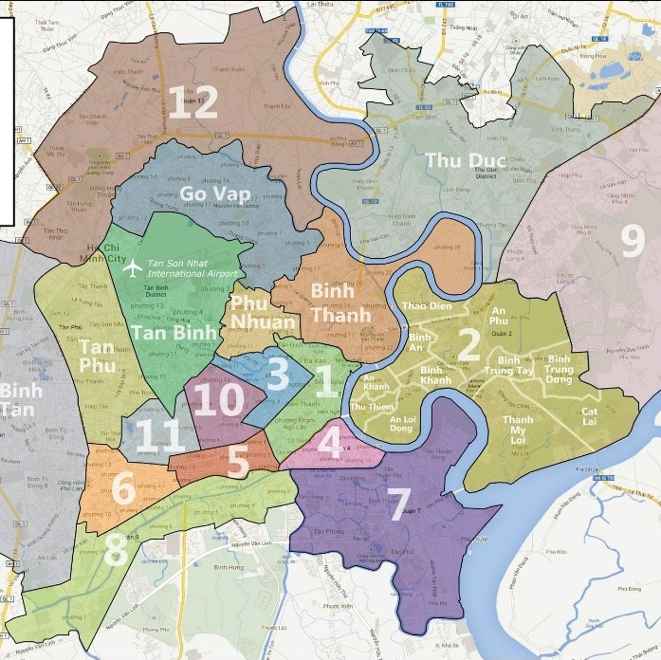
Data set
The dataset will only include districts with economic significance (close to district 1):
District 1
District 2
District 3
District 4
District 5
District 6
District 7
District 8
District 10
District 11
Binh Thanh District
Phu Nhuan District
Go Vap District
Tan Binh District

Slide 8
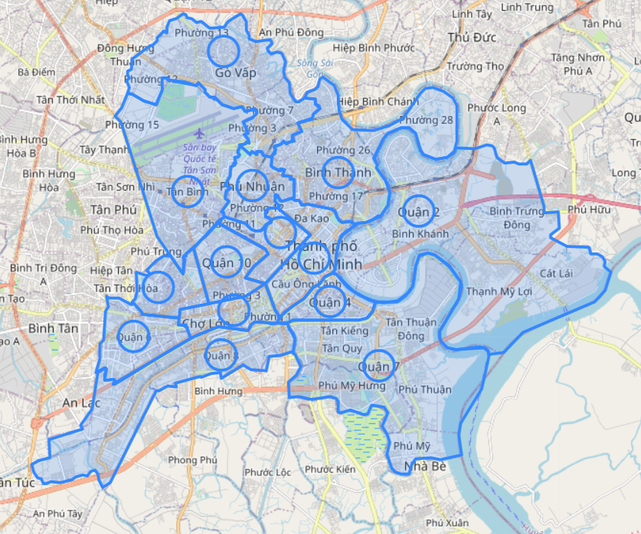
Data collection area
Since we are using average land prices, we must also use an average circular plot of land in each district.
We choose to use a circle with 600m radius so as not to exceed any district boundary while covering as much area as possible to find landmarks.

Slide 9
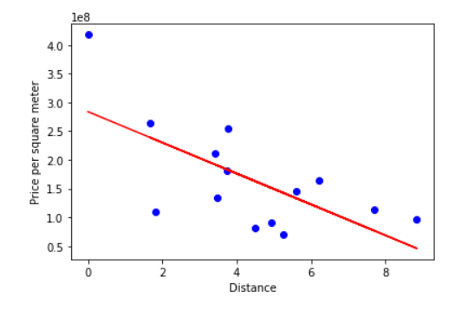
Distance from City center vs Land Prices
This plot of the data set shows that the distance between a district and the city center and its land price has a linear inverse relationship.
Although it seems to not be a very good linear relationship, this is most likely due to the data set being too small.

Slide 10
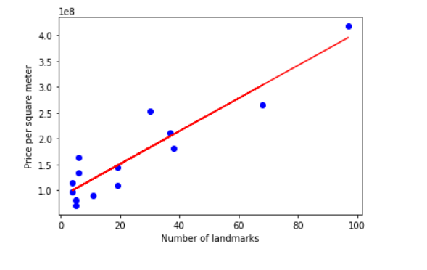
Number of landmarks vs Land Prices
This plot of the data set shows an almost perfect linear relationship between the number of landmarks in a district and its average land price.
Therefore, Linear regression is a good choice.
The model itself is Multiple Linear Regression so it can only be operated in the notebook.

Slide 11
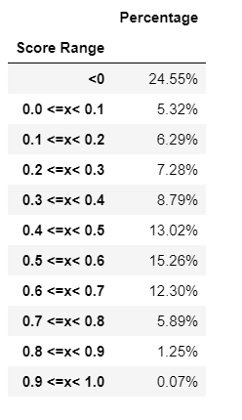

Accuracy
Due to the relatively low amount of data samples. The model’s accuracy, namely its variance score, vary wildly depending on which districts are chosen for the data or testing set.
Thus, for now, we can only evaluate how often the it produces an accurate model by calculating all possible combinations of training and testing sets, we arrive at this dataframe:
We can see that around 25% of the time, a completely inaccurate model would be built.
Most of the models tend towards the 0.4-0.7 variance score range.
More data is required to improve.

Slide 12
Difficulties
Foursquare API does not always give full Vietnamese addresses which would include information on which district the landmark belongs to, making it difficult to sort landmarks by district → unable to identify all landmarks in every district because
Foursquare API is also unable to locate every landmark. (i.e. Ben Thanh Market, a famous landmark of district 1 was not detected)
Vietnamese districts are distributed and has boundaries drawn in no particular order, there is no logic to their size and placements other than history, making it too difficult to cover the entirety of the area in each district. → the data gathering area has to be confined to circles in which not all landmarks were collected, resulting in massive loss in data.

Slide 13
Potential improvements
If the aforementioned difficulties were somehow solved, or if enough data were otherwise amassed through different means, the presented method would produce a significantly more accurate and useful model.
Other features such as average population density, which was impossible to measure in a circle, would become available for use to further enhance accuracy.

Slide 14
Conclusion
Currently, the model above has proven to be at least somewhat accurate in predicting test set prices, further testing on real data sets is required for refinement, but this model would suffice for now. The dataframe measuring accuracy will help assess the model’s improvement as more data are collected.
The purpose of this project was to identify the different types of landmarks in the central districts of Ho Chi Minh city, Vietnam and gauge their effects on land prices while using their distance to the city center as a factor to improve accuracy. This is to aid stakeholders who have, or are wishing to invest, in real estate in Ho Chi Minh city.
With this model, they will be able to predict the change in land prices as landmarks are built and/or demolished in each district and make more accurate judgements on land prices when they are anticipating buying or selling.
More data is required to make the model accurate.

Slide 15

Thank you!

